Slide 1
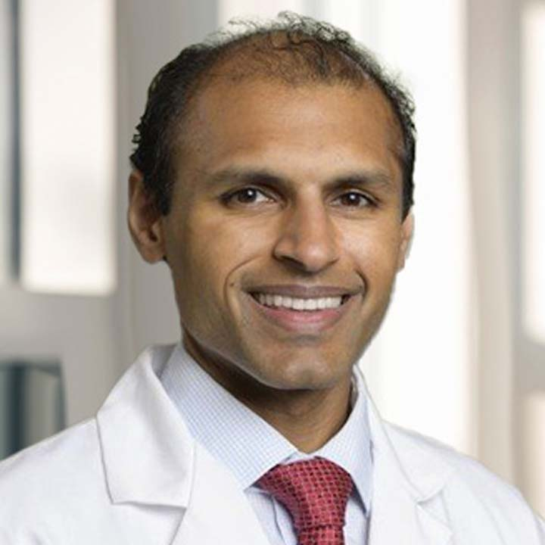
Clinical Storyboard
MagnetOs Flex Matrix in a 2-level thoracolumbar fusion in a spinal oncology case
Dr. Vikram Chakravarthy is a neurosurgeon and spine oncologist at The Ohio State University Wexner Medical Center. Dr. Chakravarthy completed a combined orthopedic/neurosurgery fellowship in complex spine and deformity at the Cleveland Clinic and a second fellowship at Memorial Sloan Kettering Cancer Center in neurosurgical (spine) oncology.
In the interactive Clinical Storyboard below, one of Dr. Chakravarthy’s patients is followed before a partial corpectomy and fusion with MagnetOs Flex Matrix through 6 months with computed tomography imaging.

Slide 2
Demographics
48-year-old female
BMI 23
Past medical history: breast cancer

Slide 3
Pre-operative Exam
Clinical Observations:
ODI: 40
VAS : back 4/10, with activity 9/10
Multiple osseous metastasis with Bilsky grade 2
T12 metastatic epidural cord compression
Cancer Details and Pre-op Treatment:
Breast Cancer ER+, PR+, HER2+
Bone metastases
Chemotherapy: Docetaxel+Trastuzumab+Pertuzumab; Zoladex; Anastrazole
Radiation: L3-sacrum and bilateral SI joints

Slide 4
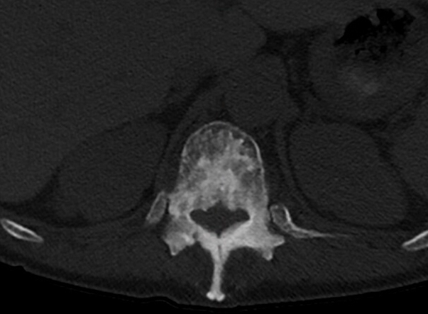
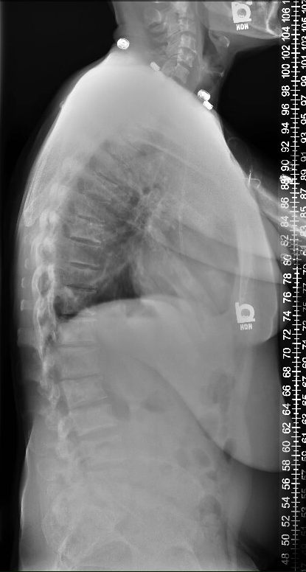
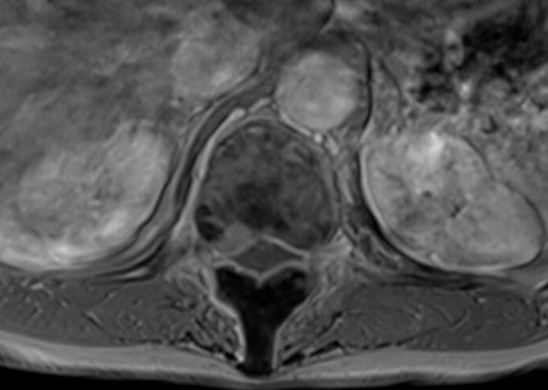
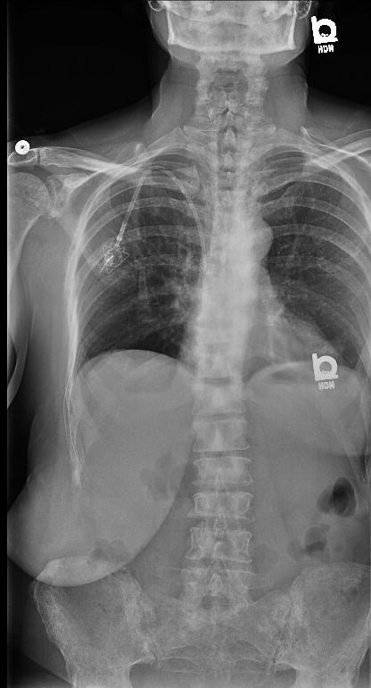
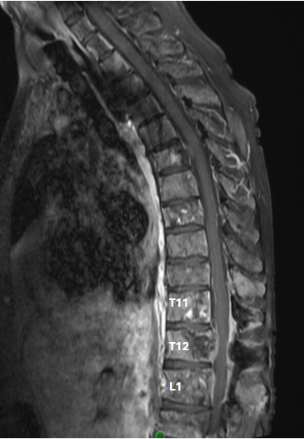
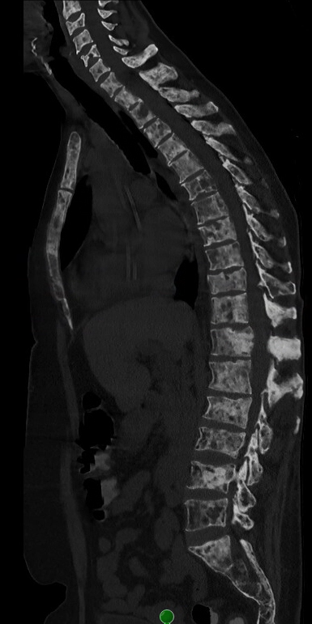
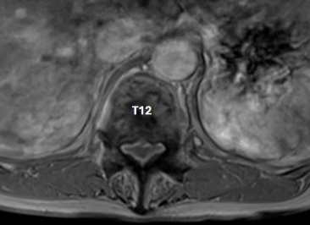
Pre-operative X-rays, MRI, and CT
T12
T12
T12
Notes:
There is diffuse widespread metastatic disease to the thoracic spine and remaining visualized osseous structure.
Hypertrophic changes of the posterior T12 vertebral body with a new focal enhancing lesion along the right dorsal aspect along with new epidural tumor along with degenerative changes contribute to severe thecal sac stenosis and mild to moderate compression of the conus (Bilsky grade 2). The most compressive level was treated to maintain posture.
There is severe narrowing of the right subarticular zone. Epidural tumor also extends into the right neural foramina.
There is mild dextroscoliosis of the thoracolumbar spine with a Cobb angle of 11 degrees.
Diffuse osseous metastatic disease is present throughout the cervical, thoracic, and lumbar spine, with mixed lytic and sclerotic lesions present.

Slide 5
Procedure
T11-L1 instrumented fusion with partial T12 corpectomy and tumor separation
Used an XL MagnetOs Flex Matrix
Carbon fiber reinforced PEEK screws and rods were used without a cage

Slide 6
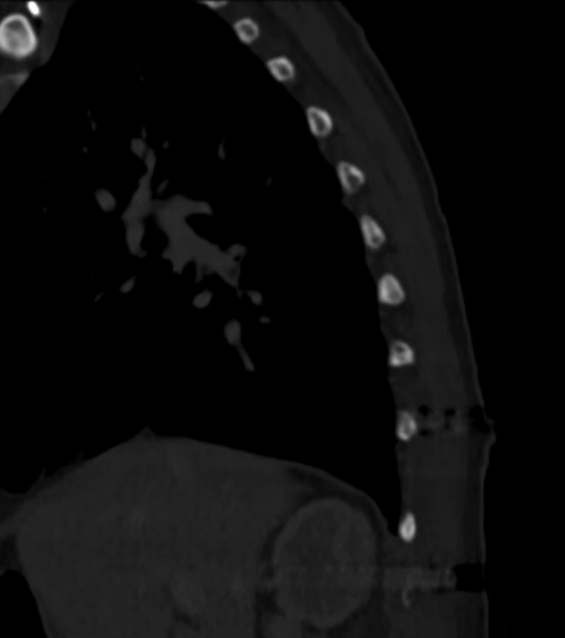
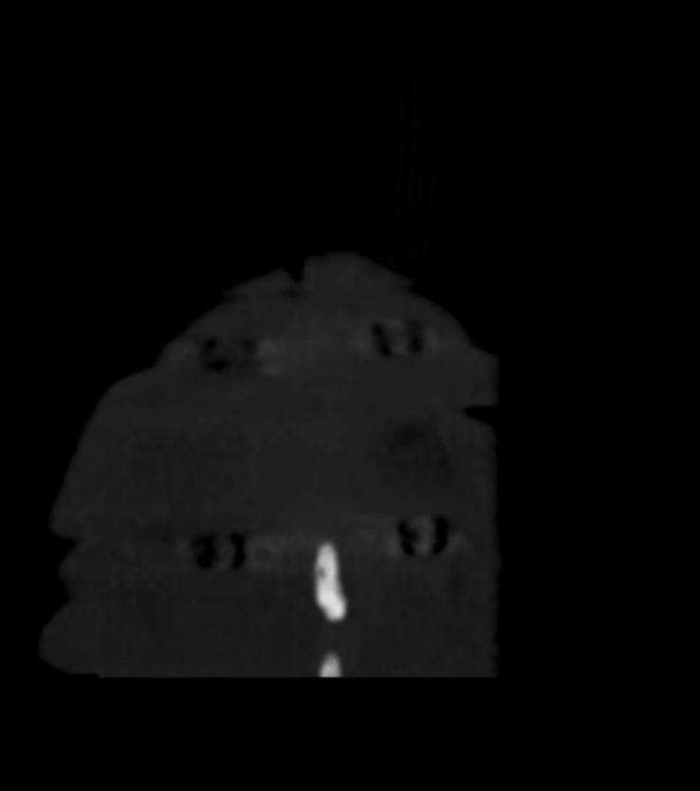
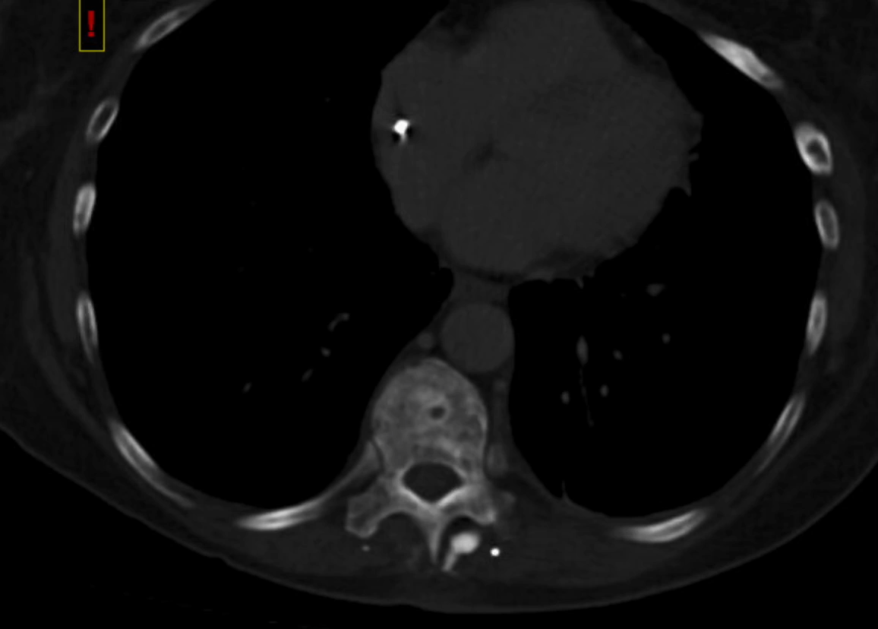
3 month CTs
Notes:
On axial view, decompression of spinal cord is evident following circumferential decompression of the spinal cord after separation surgery for metastatic spinal cord compression. Bony arthrodesis evident on right side spanning the rod.
Sagittal and coronal CTs demonstrate bony arthrodesis between T11 and L1 pedicle screws on the right side of the spine. There does not appear to be bony arthrodesis spanning the rod on the left side although there appears to be bone remodeling around the two left pedicle screws.

Slide 7
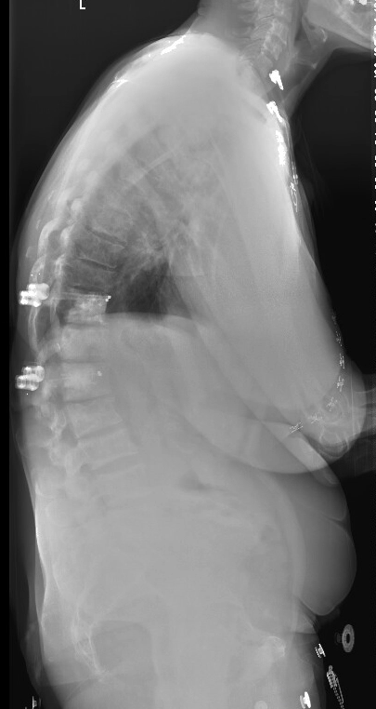
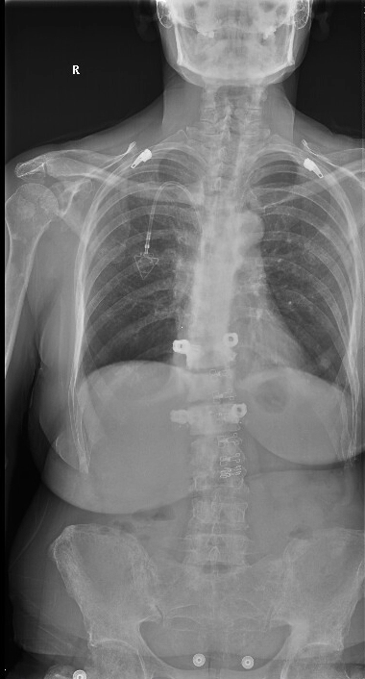
6 month X-Rays
Notes:
Stable construct without evidence of hardware failure.

Slide 8
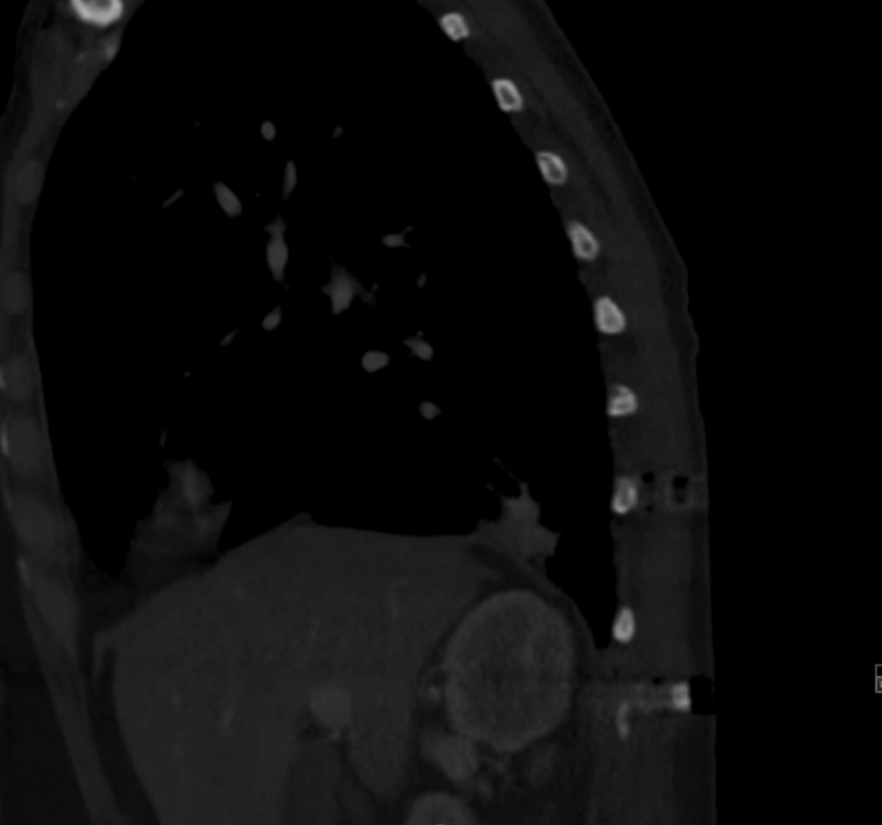
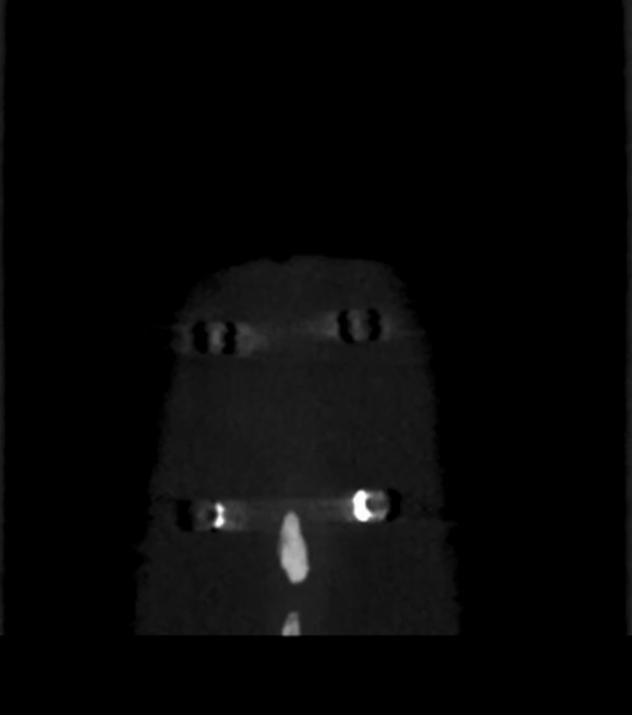
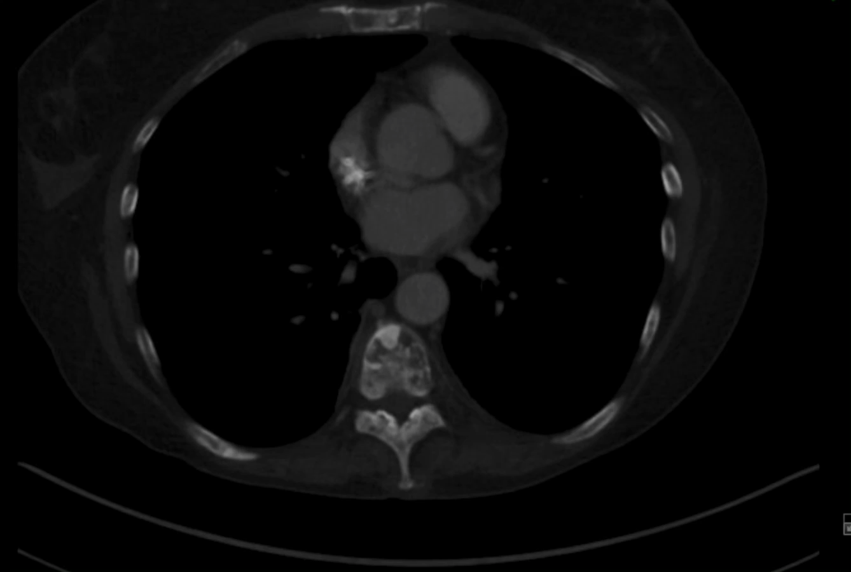
6 month CTs
Notes:
The axial CT at 6 month demonstrates no hardware failure and adequate fixation between T11 and L1.
The sagittal and coronal CTs reveal an increase in the bony arthrodesis on the right side compared to 3 months. Spanning arthrodesis is not visible on the left side, although some bone may be forming at the core of the graft.
The coronal CT reveals more extensive osseus material present around the left T11 and L1 pedicle screws.
*Differences in bone formation between the right and left sides are likely due to complete facetectomy on the left and medial facetectomy on the right without pedicle resection.

Slide 9
Post-op clinical observations
ODI : 30
VAS: Back 3/10
Ambulates short distances without difficulty; uses a wheelchair for long distances

